Slide 1


SVD, PCA, and dimension reduction
CS-Stat 221, Intro Machine Learning

Slide 2
Consider genotype data
Individuals (few 1000s)
Genetic loci (few 100k)
https://hagsc.org/hgdp/files.html

Slide 3
Consider genotype data
Individuals (few 1000s)
Genetic loci (few 100k)
Convert to numbers
compare columns ?
Would like to visualize in 2 dimesions:
1000 x 2 ?

Slide 4
Suppose your data looks like genotype data
Individuals (few 1000s)
Genetic loci (few 100k)

Slide 5
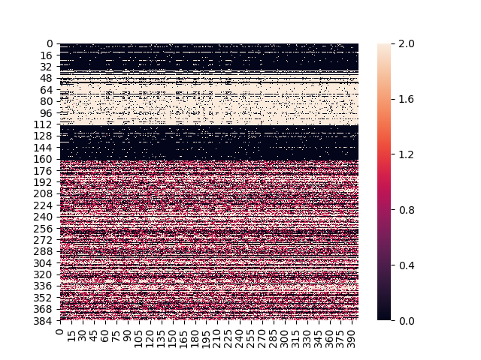
Individuals
Some rows are similar to each other, some columns are similar to each other
The data are in some way “predictable”
Can we build a low-complexity object that explains most of the data matrix.
Genetic loci

Slide 6
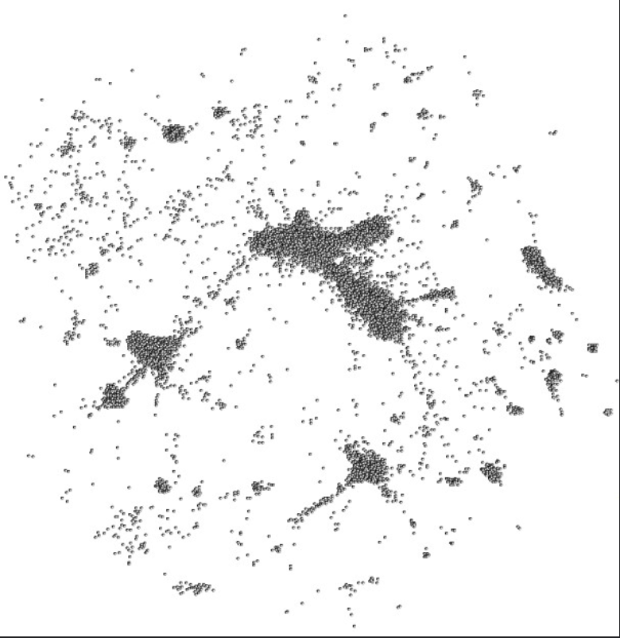
Roadmap
Dimension reduction
Absolute essentials of eigenvectors and eigenvalues
SVD and PCA
Examples

Slide 7
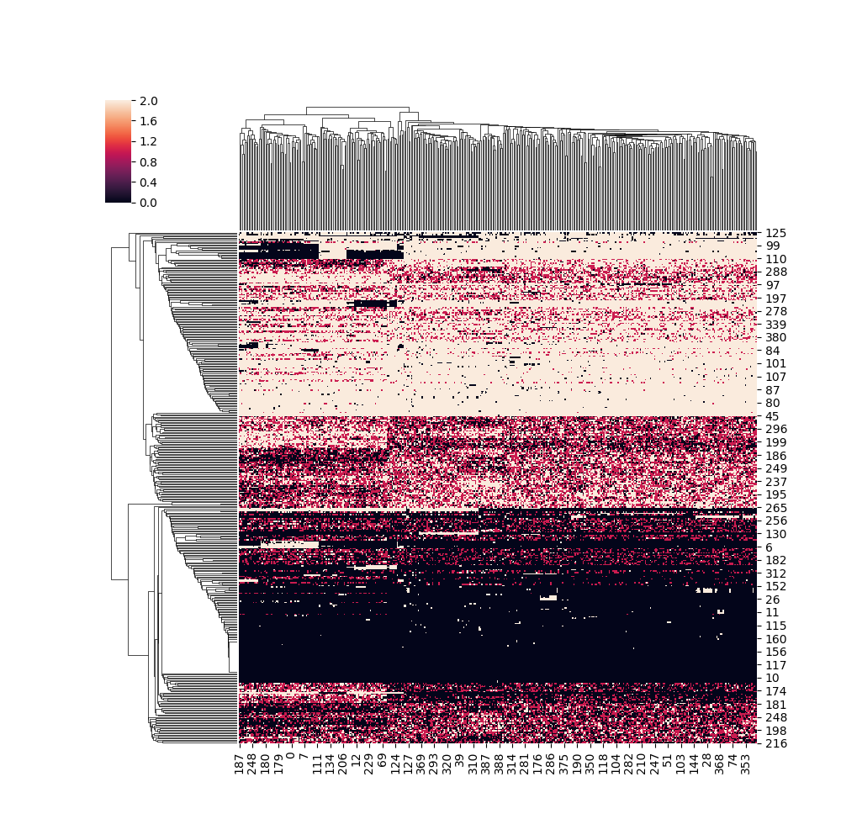
Now that looks like structure
Individuals
Individuals (400)
Reorder rows and columns to put similar rows next to each other?
Libraries to make exactly this sort of eye-candy are mature. This one is sanborn.clustermap
Organizing data like this is deeply satisfying—it makes us think we have discovered truth.
What if I told you linear algebra could do this?
Genetic loci
Genetic loci (400)

Slide 8
Why Reduce dimensions?
r
“reduced
features”
Reducing the number of dimensions can make ML easier
May reduce noise.
Can exploit unlabeled data to make nicer inputs for ML
We need dimension reduction and categorization to understand high-dimensional data
Useful for making visualizations of high-dimensional data.
m columns
“features”
A
B
n samples
n rows
”samples”

Slide 9
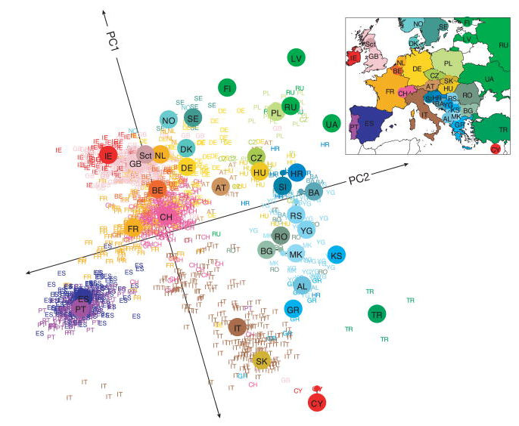
Example: Genes mirror geography within Europe
Novembre et al, 2008
Genes mirror geography within Europe
10.1038/nature07331
m x n = 200k genetic loci x 1400 individuals

Slide 10

How many dimensions again?
n x m can be large (compared to our computers and our displays):
Twitter (500M tweets / day, May 2020)
Youtube (2.5 billion views / day)
Natural Language processing (10⁴-10⁶ words)
Netflix prize was 500K users x 20K movies
Biochemical or genetic assays (10⁴-10⁷ features of interest x sample size)
Image processing (10⁷ pixels easy)

Slide 11
Definition of eigenvectors and eigenvalues
square matrix
n x n
There exists a set of vectors {e_{i}}
That has the following nice property
ith eigenvalue
ith eigenvector
n x 1
A e_{i} = λ_{i} e_{i}
n
A
e
e
=
square
matrix
n
λ_{i}
n x n
n x 1
n x 1

Slide 12
Eigenvalue decomposition
These vectors can be constructed orthogonal (zero inner products)
and normal ( x dot x = 1 )
A = Sum_{i} e_{i}^{T} λ_{i} e_{i}
n
A
Q
e₂
e₃
e₄
Σ
Q⁻¹
λ₁
=
λ₂
e₂^{T}
n
λ₃
e₃^{T}
λ₄
e₄^{T}
square
matrix
eigenvectors
(orthogonal)
eigenvalues
(diagonal)
eigenvectors
(orthogonal)
A
Q⁻¹
Σ
Q

Slide 13
Eigenvalue decomposition
import numpy as np
from numpy import linalg as LA
# A library function will take a square matrix and give
# back a vector of eigenvalues and a matrix of eigenvectors.
A=np.array( [ [16, 2, 3, 13 ],[5, 11, 10, 8], [9, 7, 6, 12], [4, 14, 15, 1] ])
evalues, evectors = LA.eig(A)
print(evalues)
print(evectors)
B=np.dot(np.dot(evectors , evalues * np.eye(4)) , LA.inv(evectors))

Slide 14
Singular Value Decomposition (SVD)
n
A
Q
e₂
e₃
e₄
Σ
Q⁻¹
λ₁
=
λ₂
e₂^{T}
n
λ₃
e₃^{T}
λ₄
e₄^{T}
Eigenvalue decomposition is very nice, but only applies to square data matrices.
Singular Value Decomposition (SVD) is a generalization for rectangular matrices

Slide 15
Singular Value Decomposition (SVD)
left
singular
vectors
diagonal
singular
values
right
singular
vectors
data
matrix
m rows
r
r
m
A
U
Σ
V^{T}
r
r
n samples
=
n
Eigenvalue decomposition is very nice, but only applies to square data matrices.
Singular Value Decomposition (SVD) is a generalization for rectangular matrices

Slide 16
Constructing SVD - rows
Recipe for building SVD:
m
n
n
A
A^{T}
AA^{T}
=
m
n
n
n
This is the matrix of inner products between rows; summed over all the samples

Slide 17
Constructing SVD - rows
n
AA^{T}
U
σ
U^{T}
=
n
n
Now take the eigenvalue decomposition of AA^{T}

Slide 18
Constructing SVD - rows
n
AA^{T}
U
σ
U^{T}
=
n
0
0
0
Now take the eigenvalue decomposition of AA^{T}
I have a bunch of zero eigenvalues, so I have a bunch of eigenvectors that can’t contribute to the sum

Slide 19
Constructing SVD - rows
n
r
r
n
AA^{T}
U
σ
U^{T}
r
r
=
n
n
Now take the eigenvalue decomposition of AA^{T}
U (n x r) , σ (r), U^{T} (r x n)

Slide 20
Constructing SVD - columns
n
m
m
A^{T}
A
A^{T}A
=
m
m
n
This matrix has dimensions m_features x m_features

Slide 21
Constructing SVD - columns
Eigenvalue decomposition again
m
r
r
m
A^{T}A
=
V
σ
V^{T}
r
r
m
m
Because of the relationship between A^{T}A and AA^{T} these two matrices have the same eigenvalues. (But one is m x m and one is n x n !!)
Some of the eigenvalues have to be zero in the larger matrix

Slide 22
Singular Value Decomposition (SVD)
data
matrix
left
singular
vectors
diagonal
singular
values
right
singular
vectors
m
r
r
n
A
U
Σ
V^{T}
r
r
=
n
n
I have two sets of basis vectors and one set of r singular values.
Two powers of A -> elements of Σ are square roots of eigenvalues

Slide 23
Singular Value Decomposition (SVD)
data
matrix
left
singular
vectors
diagonal
singular
values
right
singular
vectors
m
r
r
m
A
U
Σ
V^{T}
r
r
=
eigenfeatures
n
n
eigensamples
I have two sets of basis vectors and one set of r singular values.
Two powers of A -> elements of Σ are square roots of eigenvalues

Slide 24
SVD
We could calculate SVD ourselves in two lines –
but we shouldn’t
import numpy as np
from numpy import linalg as LA
# https://numpy.org/doc/stable/reference/generated/numpy.linalg.svd.html
U, SIGMA VT = LA.svd(A)
,

Slide 25
Approximate, truncated SVD
The library functions use convergence or optimization to find approximate matrix factorizations.
Does not actually build or store A^{T}A
Approximate and truncated decompositions are cheaper to compute.
import numpy as np
from numpy import linalg as LA
from sklearn.utils.extmath import randomized_svd
# https://scikit-learn.org/stable/modules/generated/sklearn.utils.extmath.randomized_svd.html
U, SIGMA, VT = randomized_svd(A, n_components=50)

Slide 26
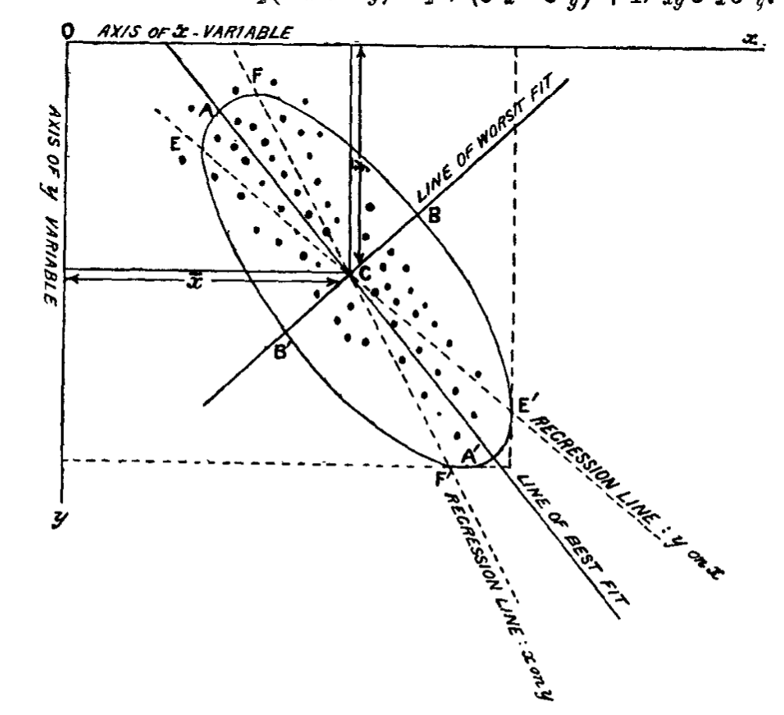
Principal Component analysis
SVD is a just linear algebra + geometry interpretation of the columnwise & rowwise inner products.
PCA is the doctrine of using vectors derived from SVD to interpret data.
The data points are rotated onto the singular vectors, renamed PCA coordinates
XV^{T} = T (new coordinates)
(n x m) * (m x r) = (n x r)
Can make pretty pictures
m
r
Pearson, 1901
doi: 10.1080/14786440109462720

Slide 27
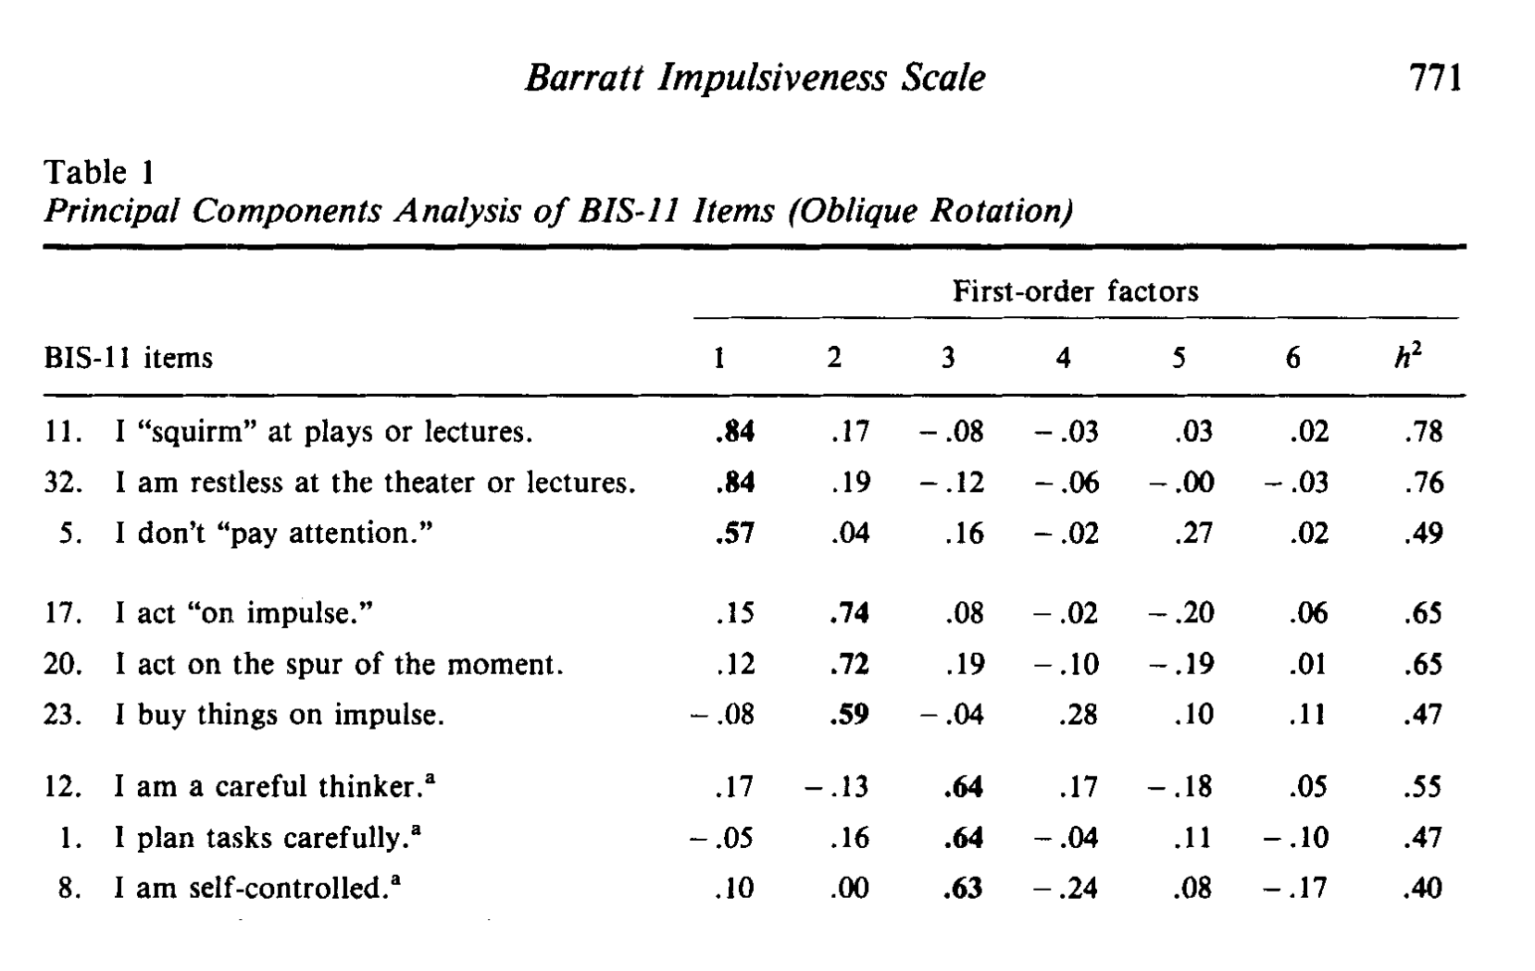
Patton et al. 1995 Factor structure of the Barratt Impulsiveness Scale
doi: 10.1002/1097-4679(199511)51:6<768::AID-JCLP2270510607>3.0.CO;2-1

Slide 28
Patton et al. 1995 Factor structure of the Barratt Impulsiveness Scale
doi: 10.1002/1097-4679(199511)51:6<768::AID-JCLP2270510607>3.0.CO;2-1

Slide 29
Data correlations here used to inform reduction of dimension from 35-question survey to 6 scores.

Slide 30
Genes mirror geography within Europe
Novembre et al, 2008
Genes mirror geography within Europe
10.1038/nature07331
m x n = 200k genetic loci x 1400 individuals

Slide 31
Genes mirror geography within Europe
0.30%
Principal components and eigenvalues come back from largest to smallest magnitude.
It is conventional to report principal components along with the fraction of variance explained by each
0.15%
Novembre et al, 2008
Genes mirror geography within Europe
10.1038/nature07331

Slide 32

Federalist Papers
What if your data looks like this?
NEW | 7 | 3 | 2 | 1 | 1 | 2 | 11 | 3 | 7 | 2 | 2 | 4 | 4 | 6 | 3 | 2 | 1 | 3 | 2 | 2 | 7 | 7 | 2 | 5 | 5 | 4 | 2 | 2 | 4
SO | 3 | 4 | 4 | 5 | 3 | 4 | 4 | 5 | 5 | 4 | 4 | 6 | 3 | 6 | 2 | 3 | 4 | 2 | 4 | 2 | 7 | 9 | 1 | 4 | 1 | 10 | 2 | 1 | 8
THEY | 6 | 22 | 5 | 17 | 11 | 11 | 7 | 13 | 20 | 11 | 9 | 8 | 3 | 17 | 15 | 14 | 7 | 12 | 9 | 7 | 7 | 15 | 4 | 5 | 9 | 12 | 5 | 8 | 7
AGAINST | 2 | 1 | 3 | 6 | 5 | 4 | 1 | 5 | 5 | 6 | 1 | 3 | 1 | 4 | 4 | 6 | 2 | 4 | 6 | 0 | 6 | 1 | 1 | 6 | 4 | 6 | 0 | 8 | 3
ANY | 6 | 1 | 4 | 5 | 3 | 0 | 6 | 2 | 4 | 4 | 4 | 7 | 3 | 2 | 3 | 11 | 2 | 2 | 6 | 0 | 6 | 7 | 9 | 6 | 4 | 10 | 8 | 2 | 6
EITHER | 2 | 0 | 5 | 4 | 1 | 5 | 3 | 1 | 3 | 1 | 3 | 0 | 0 | 1 | 1 | 3 | 1 | 0 | 1 | 0 | 6 | 4 | 0 | 4 | 1 | 0 | 0 | 3 | 0
FOR | 13 | 14 | 11 | 12 | 8 | 14 | 15 | 9 | 11 | 18 | 19 | 8 | 2 | 19 | 18 | 9 | 12 | 8 | 8 | 17 | 6 | 21 | 16 | 10 | 10 | 22 | 7 | 16 | 17
GOVERNMENT | 5 | 4 | 5 | 11 | 2 | 1 | 1 | 1 | 8 | 4 | 2 | 6 | 7 | 7 | 4 | 10 | 4 | 3 | 1 | 2 | 6 | 8 | 11 | 1 | 4 | 6 | 13 | 10 | 5
GUARANTY | 0 | 0 | 0 | 0 | 0 | 0 | 0 | 0 | 0 | 0 | 0 | 0 | 0 | 0 | 0 | 0 | 0 | 0 | 0 | 0 | 6 | 0 | 0 | 0 | 0 | 0 | 0 | 0 | 0
NATIONAL | 1 | 3 | 14 | 7 | 0 | 4 | 2 | 2 | 2 | 2 | 4 | 4 | 4 | 2 | 9 | 9 | 8 | 0 | 2 | 0 | 6 | 6 | 6 | 1 | 7 | 7 | 5 | 7 | 5
NATURE | 0 | 0 | 0 | 0 | 0 | 1 | 0 | 1 | 0 | 2 | 1 | 2 | 0 | 2 | 2 | 1 | 3 | 0 | 1 | 2 | 6 | 2 | 1 | 0 | 1 | 1 | 0 | 0 | 0
ON | 9 | 8 | 6 | 11 | 5 | 2 | 13 | 11 | 9 | 18 | 5 | 12 | 3 | 17 | 10 | 4 | 2 | 16 | 17 | 7 | 6 | 9 | 2 | 11 | 11 | 7 | 4 | 1 | 3
OTHER | 3 | 3 | 7 | 10 | 2 | 5 | 4 | 4 | 4 | 16 | 6 | 11 | 1 | 6 | 3 | 2 | 7 | 2 | 5 | 4 | 6 | 3 | 7 | 6 | 8 | 2 | 2 | 4 | 1
OWN | 4 | 1 | 0 | 4 | 0 | 0 | 4 | 0 | 2 | 3 | 4 | 1 | 1 | 4 | 2 | 2 | 0 | 2 | 3 | 1 | 6 | 0 | 1 | 0 | 2 | 3 | 1 | 3 | 1
STATES, | 0 | 0 | 6 | 0 | 1 | 3 | 4 | 4 | 4 | 1 | 5 | 1 | 3 | 3 | 1 | 2 | 1 | 1 | 1 | 2 | 6 | 10 | 2 | 1 | 6 | 1 | 1 | 3 | 1
UPON | 6 | 1 | 0 | 0 | 0 | 4 | 11 | 3 | 4 | 0 | 6 | 7 | 2 | 0 | 10 | 6 | 6 | 1 | 0 | 1 | 6 | 13 | 7 | 7 | 1 | 6 | 4 | 3 | 10
COULD | 1 | 1 | 1 | 2 | 0 | 0 | 2 | 3 | 3 | 2 | 3 | 2 | 0 | 1 | 3 | 12 | 1 | 2 | 2 | 1 | 5 | 3 | 0 | 4 | 3 | 7 | 0 | 2 | 3
KIND | 0 | 2 | 1 | 0 | 1 | 0 | 0 | 0 | 3 | 0 | 1 | 1 | 0 | 0 | 5 | 4 | 1 | 0 | 0 | 0 | 5 | 3 | 0 | 1 | 2 | 1 | 1 | 1 | 1
SHALL | 7 | 1 | 0 | 6 | 1 | 1 | 1 | 0 | 4 | 2 | 3 | 1 | 3 | 0 | 1 | 1 | 1 | 0 | 2 | 0 | 5 | 2 | 2 | 1 | 6 | 2 | 0 | 0 | 3
SHOULD | 1 | 3 | 4 | 1 | 4 | 2 | 7 | 4 | 4 | 0 | 3 | 4 | 0 | 2 | 6 | 6 | 2 | 1 | 0 | 0 | 5 | 8 | 2 | 6 | 6 | 6 | 2 | 9 | 7
STATES | 2 | 1 | 4 | 1 | 0 | 4 | 25 | 7 | 5 | 1 | 7 | 8 | 5 | 8 | 8 | 6 | 2 | 0 | 2 | 0 | 5 | 14 | 2 | 2 | 3 | 6 | 1 | 1 | 4
TOTAL | 0 | 0 | 0 | 0 | 0 | 0 | 1 | 0 | 0 | 0 | 0 | 0 | 0 | 0 | 0 | 0 | 0 | 0 | 0 | 0 | 5 | 0 | 0 | 0 | 0 | 1 | 0 | 0 | 0
VALUE | 0 | 1 | 0 | 0 | 0 | 0 | 0 | 0 | 0 | 1 | 1 | 0 | 0 | 0 | 1 | 0 | 0 | 0 | 1 | 0 | 5 | 0 | 0 | 0 | 0 | 0 | 0 | 0 | 0
WANT | 0 | 0 | 2 | 1 | 0 | 1 | 0 | 1 | 0 | 0 | 0 | 1 | 0 | 1 | 1 | 0 | 0 | 0 | 0 | 1 | 5 | 6 | 1 | 0 | 0 | 0 | 0 | 0 | 1
WHO | 8 | 7 | 1 | 3 | 3 | 7 | 2 | 0 | 3 | 9 | 4 | 1 | 3 | 1 | 6 | 5 | 2 | 8 | 5 | 3 | 5 | 3 | 3 | 1 | 2 | 3 | 1 | 4 | 9
AT | 8 | 9 | 1 | 2 | 4 | 6 | 11 | 11 | 10 | 8 | 11 | 13 | 1 | 7 | 24 | 11 | 7 | 4 | 5 | 8 | 4 | 12 | 3 | 7 | 11 | 12 | 4 | 7 | 10
BETWEEN | 0 | 0 | 0 | 2 | 3 | 8 | 9 | 3 | 3 | 3 | 4 | 5 | 1 | 4 | 2 | 3 | 4 | 2 | 4 | 1 | 4 | 5 | 2 | 4 | 2 | 5 | 2 | 0 | 1
DUTIES | 0 | 0 | 0 | 1 | 0 | 0 | 2 | 0 | 0 | 0 | 0 | 6 | 0 | 0 | 0 | 0 | 0 | 0 | 1 | 2 | 4 | 1 | 0 | 0 | 0 | 0 | 0 | 0 | 2
EACH | 0 | 5 | 0 | 2 | 6 | 4 | 4 | 2 | 0 | 4 | 7 | 4 | 4 | 0 | 5 | 1 | 2 | 2 | 2 | 4 | 4 | 4 | 2 | 1 | 2 | 0 | 2 | 2 | 0
LANDS | 0 | 0 | 0 | 0 | 0 | 0 | 3 | 0 | 0 | 0 | 0 | 0 | 0 | 0 | 0 | 0 | 0 | 0 | 0 | 0 | 4 | 0 | 0 | 0 | 0 | 0 | 0 | 0 | 0
85 documents, initially published anonymously 1787-1788
Authors’ reminiscences disagree about authorship of some of the essays
85 documents parsed into vocabulary of ~10000 “words”

Slide 33
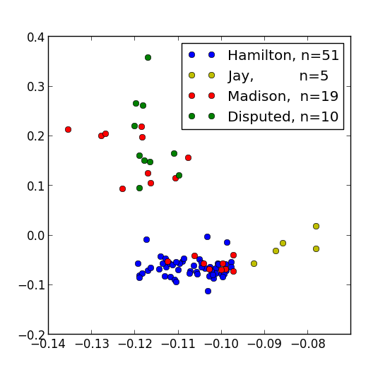
Federalist Papers
Sometimes
is not an appropriate distance score for your data.
You can run PCA on an n x n distance matrix evaluated using a domain-specific columnwise comparison.
Resulting low-dimensional coordinates visualize vocabulary/style relationships
PC2
PC1

Slide 34
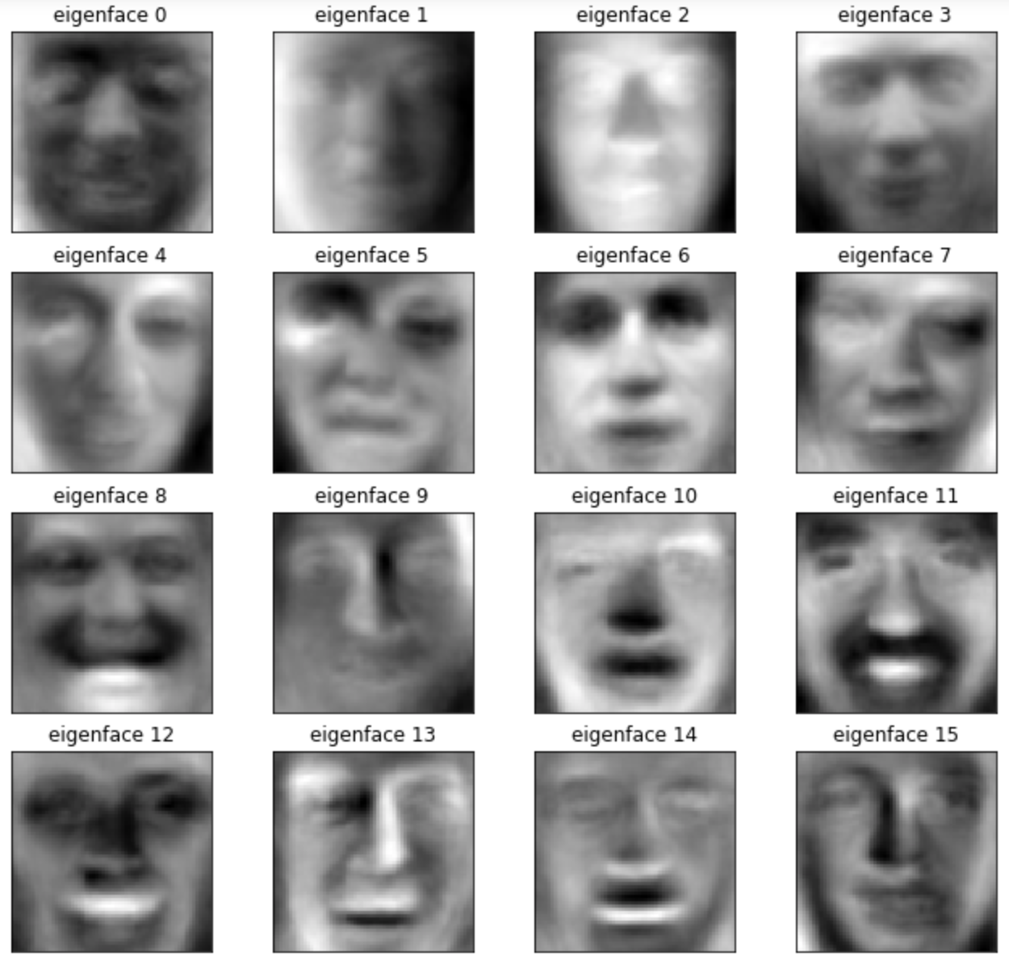
Caveats
SVD/PCA don’t know anything but the cloud of points and its correlations.
Each new sample builds a different set of basis vectors
Hard to interpret: positive and negative values in the eigenvectors
Does not handle non-numerical values—have to change the objective function for that (Netflix)

Slide 35
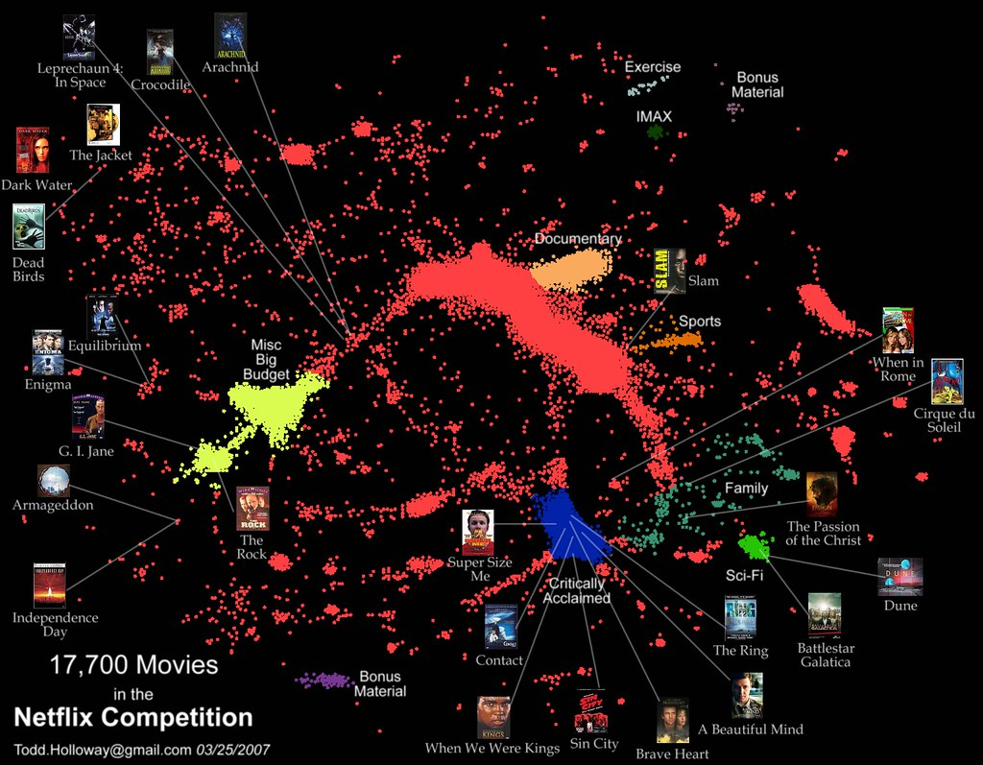

Slide 36
Linear algebra objects
n
A
v
λ
m
m x 1
number
“scalar”
vector
m x n
2d matrix

Slide 37
Matrix multiplication
r
n
n
A
B
AB
r
m
m
n x r
r x m
2d matrix

Slide 38
Principal Component analysis
m
n
n
U^{T}
A
=
r
r
T
m
This is the dimension reduction we might have asked for

Slide 39
Transformation of x1, x2 using A
e₂
x₂
x₂
e₂
x₂
x₁
e₁
e₁
x₁
x₁
Q⁻¹
λ
Q

Slide 40
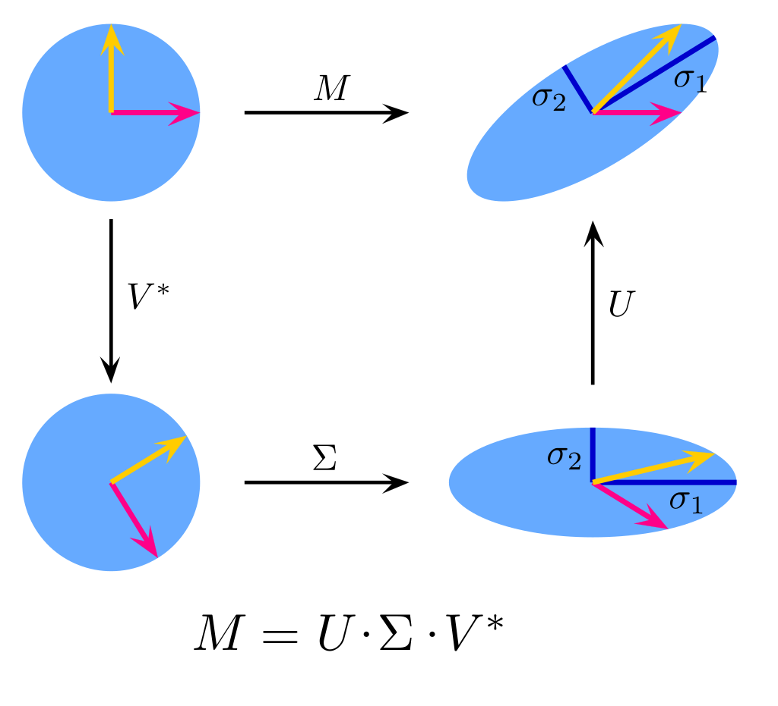
https://towardsdatascience.com/simple-svd-algorithms-13291ad2eef2

Slide 41
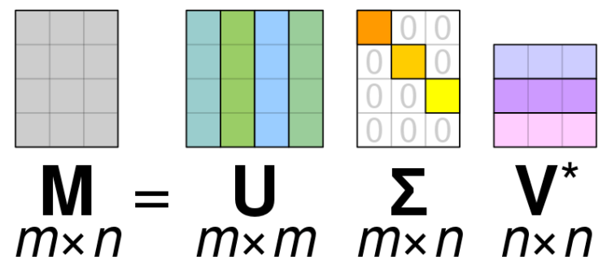
https://towardsdatascience.com/simple-svd-algorithms-13291ad2eef2

Slide 42
Eigenvalue decomposition
n
A
Q
e_{i}
Σ
Q⁻¹
=
n
λ_{i}
e_{i}^{T}
square
matrix
eigenvectors
(orthogonal)
eigenvalues
(diagonal)
eigenvectors
(orthogonal)

Slide 43
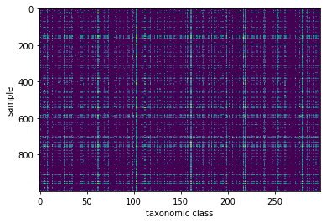
Dimension reduction
For a general matrix representing n observations of m traits:
A ( m x n)
It is unlikely that all of the elements in this matrix are independent; there is likely some “structure”
If I could replace A with an approximation of A that has fewer than n x m numbers, A will be cheaper to store, faster to copy, can run on computers with less memory.

Slide 44
Eigenvalue decomposition
A = Sum_{i} e_{i}^{T} λ_{i} e_{i}
n
A
Q
e_{i}
Σ
Q⁻¹
=
n
λ_{i}
e_{i}^{T}
square
matrix
eigenvectors
(orthogonal)
eigenvalues
(diagonal)
eigenvectors
(orthogonal)

Slide 45
Eigenvalue decomposition
n
A
Q
Σ
Q⁻¹
=
n
square
matrix
eigenvectors
(orthogonal)
eigenvalues
(diagonal)
eigenvectors
(orthogonal)

Slide 46
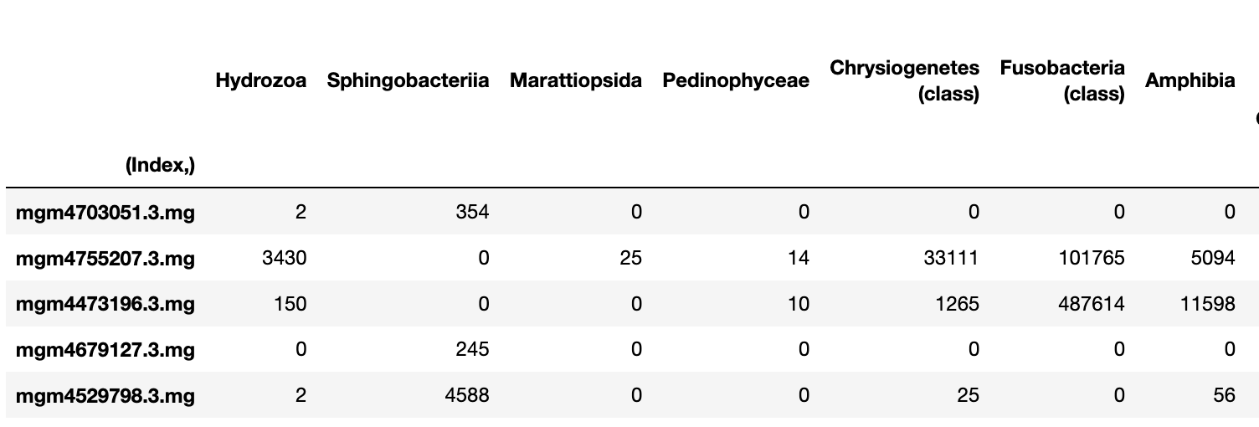
A (n x m)
(rows x columns)
(n “samples” by m “features”)

Slide 47
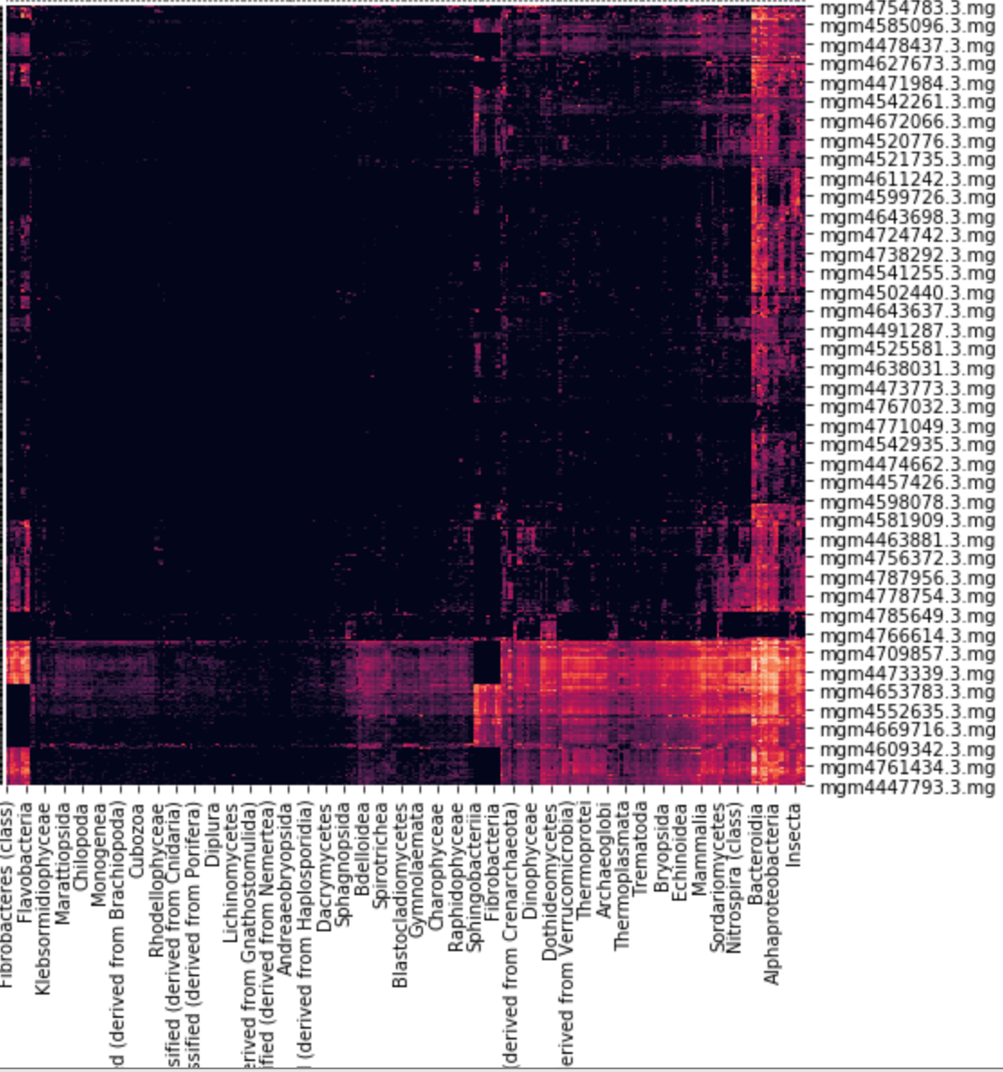
Now this looks like “structure”
Organizing data like this is deeply satisfying—it makes us think we have discovered truth.
Mature libraries to make exactly this sort of eye-candy graphs. This one is sanborn.clustermap
What if I told you linear algebra could do this?

Slide 48
Constructing SVD - rows
Recipe for building SVD:
m
n
n
A
A^{T}
AA^{T}
=
m
n
n
n
This matrix has dimensions n_samples x n_samples and each element is a sum over all features.

Slide 49
Constructing SVD - columns
Eigenvalue decomposition again
m
m
m
A^{T}A
=
V
σ
V^{T}
m
m
Because of the relationship between A^{T}A and AA^{T} these two matrices have the same eigenvalues.
Some of the eigenvalues have to be zero in the larger matrix

Slide 50
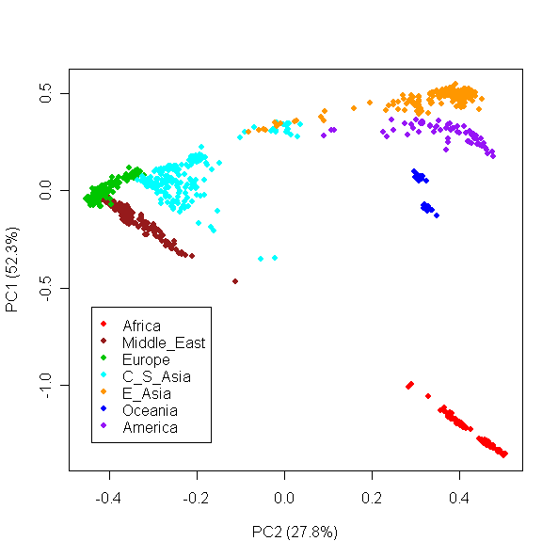
Case study: Worldwide Human Relationships Inferred from Genome-Wide Patterns of Variation
1000 individuals * 660K genetic loci probed by microarrays
This picture is gorgeous
Human Genome Diversity Panel
Li, 2008 10.1126/science.1153717

Slide 51
Case study: Worldwide Human Relationships Inferred from Genome-Wide Patterns of Variation
1000 individuals * 650K genetic loci probed by microarrays
This picture is gorgeous
“…these results reaffirm that within-population variation accounts for most of the genetic diversity in humans” ??
Human Genome Diversity Panel
Li, 2008 10.1126/science.1153717

Slide 52
Case study: Worldwide Human Relationships Inferred from Genome-Wide Patterns of Variation
Li at al didn’t take PCA on genetic variation data – first they grouped the 1000 samples into 51 groups
Calculated a per-row probability that populations differed for each column, ran PCA on these 51 group-by-genetic locus scores
This puts knowledge about the groups into the PCA—and reduces within-group variation (which ordinarily would dominate)
Then project the samples onto the group-enhanced PCA coordinates.
Human Genome Diversity Panel
Li, 2008 10.1126/science.1153717

